Slide 1
Exploratory Analysis and Recommendations for Efficient Customer Service
Shahrzad Khayatbashi
13th January 2025

Slide 2
Objectives of the analysis
Finding top countries in which orders are made and compare the revenue and order amounts in USD
Finding patterns and trends in customer interactions
Finding reasons for customer contacts
Finding places for improvement for the customer journey
Exploratory Analysis and Recommendations for Efficient Customer Service
Shahrzad Khayatbashi
13th January 2025

Slide 3
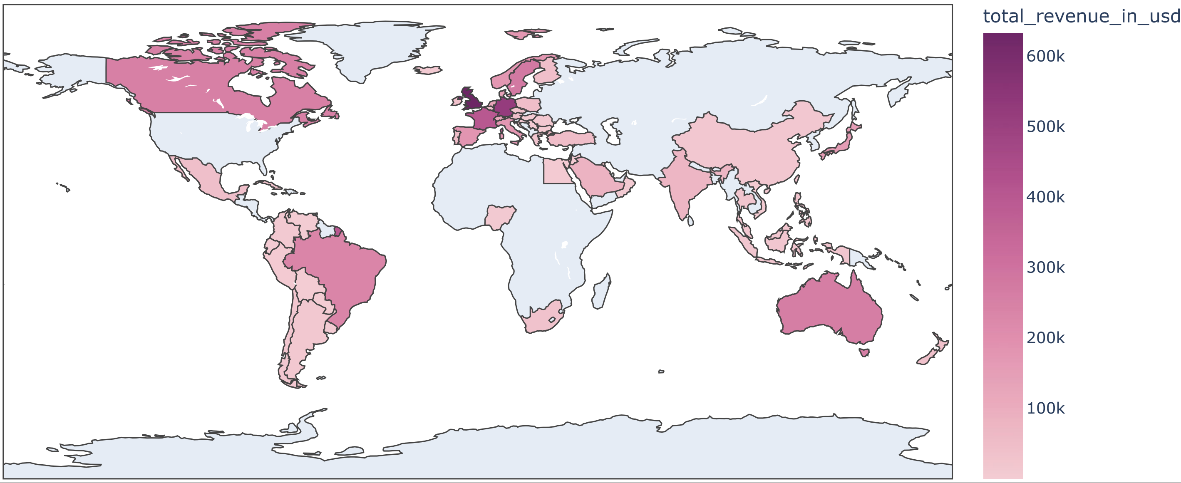
Revenue by country in USD
Does more revenue always mean more order?
Threats to validity:
Lack of business knowledge
Revenue may not be only indicator, but I studied the data based on this given perspective
Exploratory Analysis and Recommendations for Efficient Customer Service
Shahrzad Khayatbashi
13th January 2025

Slide 4
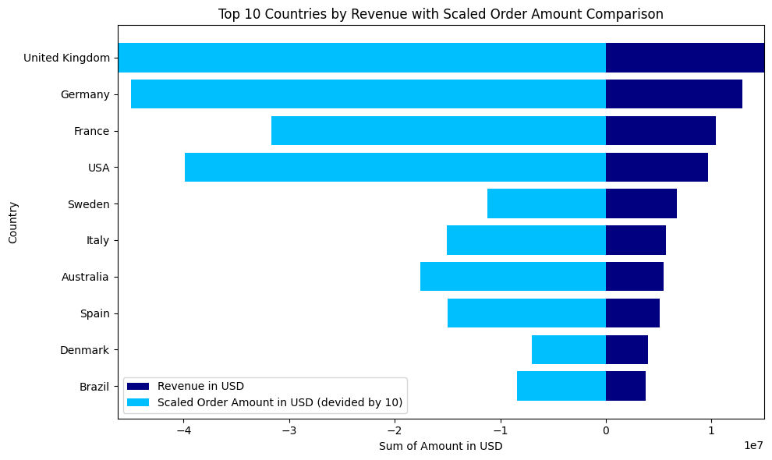
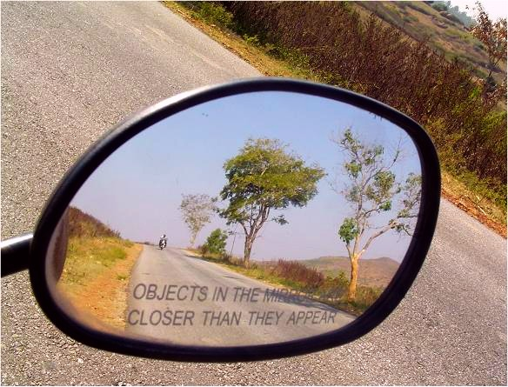
Top ten countries by sum of revenue and scaled order amounts in USD
what about the brands? Do they tell the similar story?
Key Insight: More orders don’t always mean more revenue!
Exploratory Analysis and Recommendations for Efficient Customer Service
Shahrzad Khayatbashi
13th January 2025

Slide 5
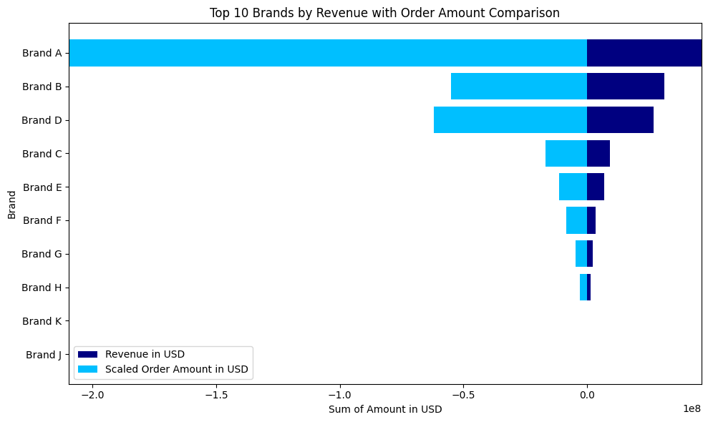
Top ten brands by sum of revenue and scaled order amounts in USD
How do partners compare when it comes to revenue and orders?
Exploratory Analysis and Recommendations for Efficient Customer Service
Shahrzad Khayatbashi
13th January 2025

Slide 6
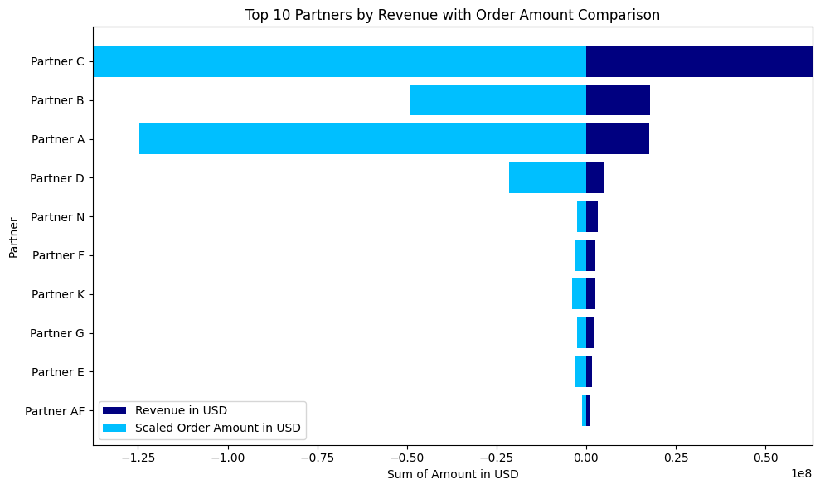
Top ten partners by sum of revenue and order amounts in USD
Could there be a link between brands and partners?
Exploratory Analysis and Recommendations for Efficient Customer Service
Shahrzad Khayatbashi
13th January 2025

Slide 7
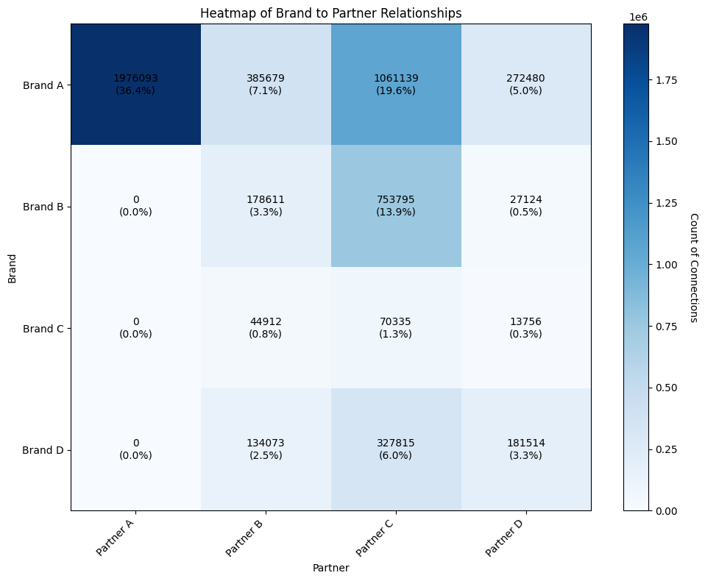
Relations between brands and partners
Do more orders mean more customer contacts, higher costs, and less revenue?
Exploratory Analysis and Recommendations for Efficient Customer Service
Shahrzad Khayatbashi
13th January 2025

Slide 8
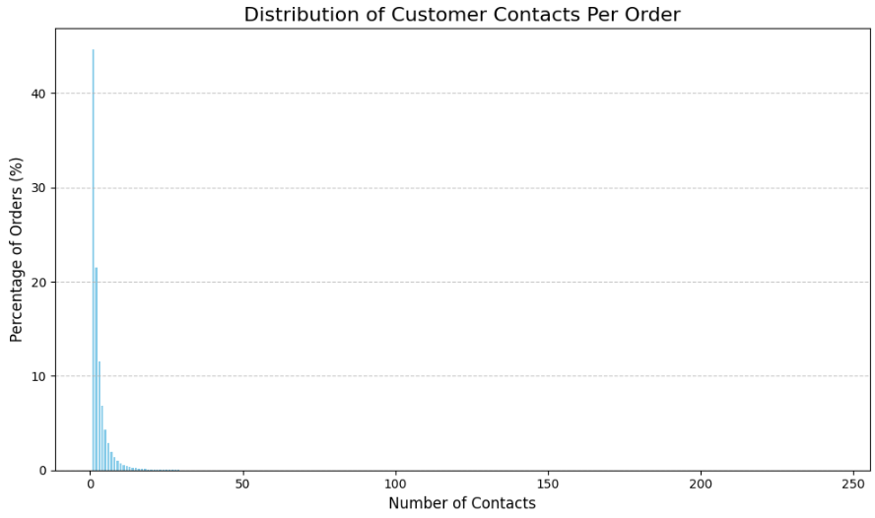
Distribution and percentage of number of contacts per order
Key Insight: Around 45 percent of orders have one contact from customers
Exploratory Analysis and Recommendations for Efficient Customer Service
Shahrzad Khayatbashi
13th January 2025

Slide 9
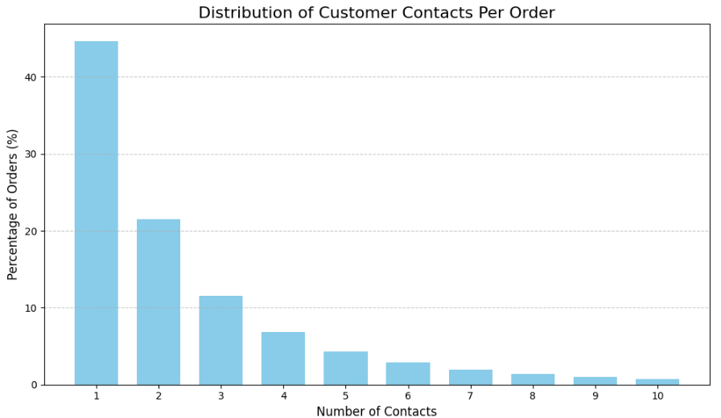

Distribution and percentage of number of contacts per order
Question: What concerns customers that they contact?
Exploratory Analysis and Recommendations for Efficient Customer Service
Shahrzad Khayatbashi
13th January 2025

Slide 10
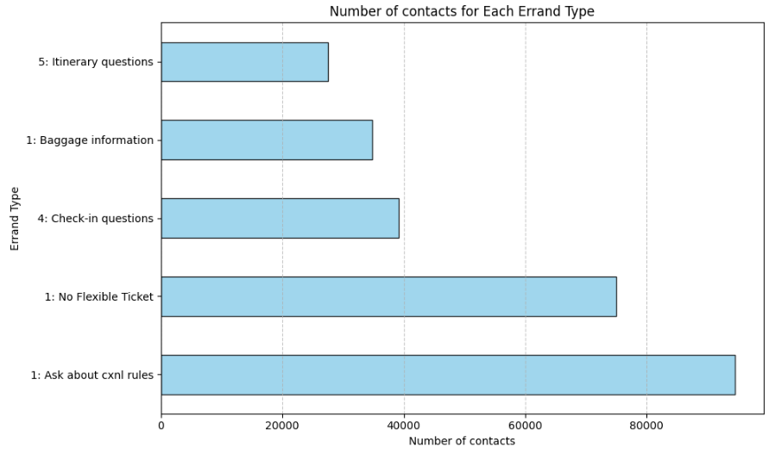
Top five reasons that customers contacts only once
Question: What type of channel customers use for contacting?
Exploratory Analysis and Recommendations for Efficient Customer Service
Shahrzad Khayatbashi
13th January 2025

Slide 11
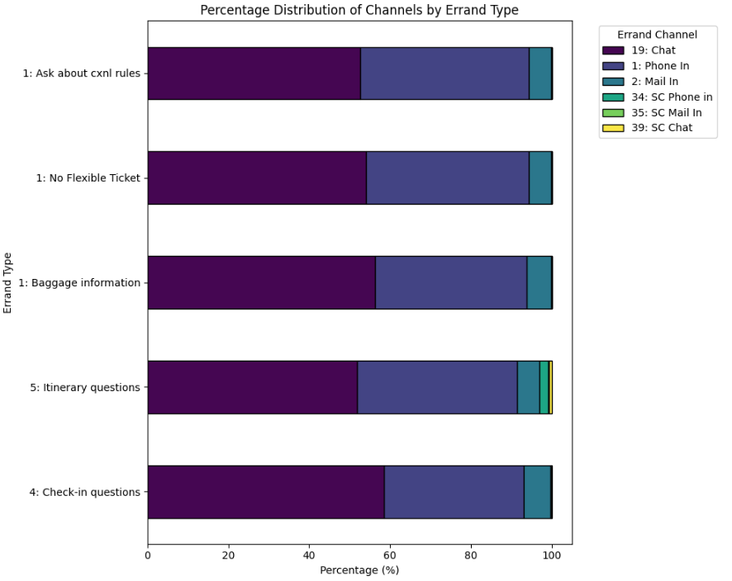
Types of channel used by customers for contacting
How does the customer journey looks like in terms of contacting and where can be improved?
Recommendations:
Using NLP techniques to investigate the most repettitive patterns in ’chat’ and ’email’.
Use models like whisper to convert audios to text for ’Phones’ to find out the questions and concerns that customers call.
Probably Implementing chatbot to handle answering the most frequent questions can be helpfull for reducing the costs.
Exploratory Analysis and Recommendations for Efficient Customer Service
Shahrzad Khayatbashi
13th January 2025

Slide 12
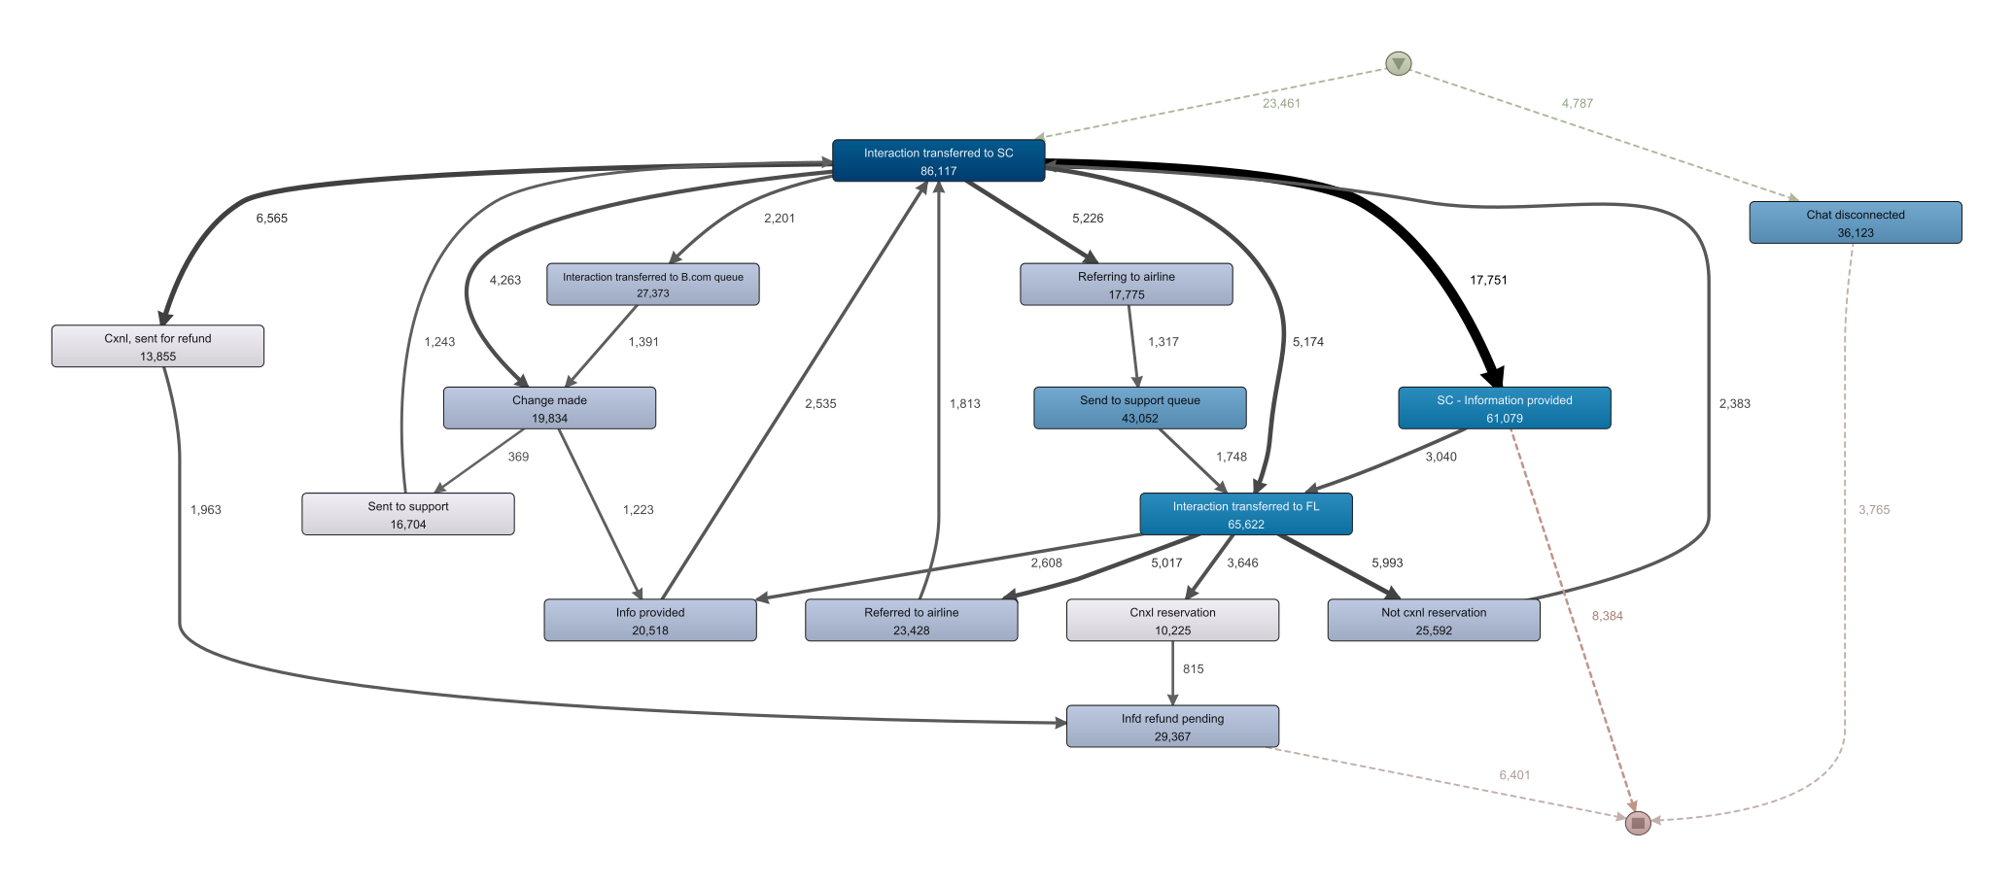






Customer interactions process
Filter:
Actions:
Include:
Transferred …
Exclude:
Create Order
Zoom:
Already on support
No change made
6.3%
Exploratory Analysis and Recommendations for Efficient Customer Service
Shahrzad Khayatbashi
13th January 2025

Slide 13
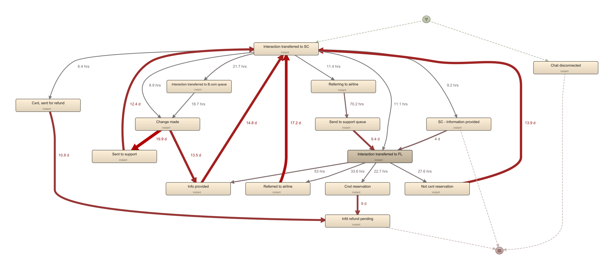
Customer interactions process
Filter:
Actions:
Include:
As we see, in average 13-19 days after a ’change is made’, customers call again for information. It might reduce the contacts if the information after the ’change is made’, is sent back to the customers.
Transferred …
Exclude:
Create Order
Zoom:
Already on support
No change made
6.3%
Exploratory Analysis and Recommendations for Efficient Customer Service
Shahrzad Khayatbashi
13th January 2025

Slide 14
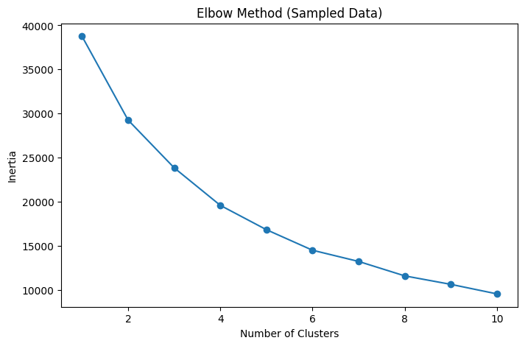


How many cluster shall we pick?
Selected features:
Brand A
Bran B
Brand D
Brand Others
Partner A
Partner B
Partner C
Partner Others
order:num_of_booking_system
order:num_of_pnr
First I applied Elbow Method on Sample data of 20,000 Rows
Exploratory Analysis and Recommendations for Efficient Customer Service
Shahrzad Khayatbashi
13th January 2025

Slide 15
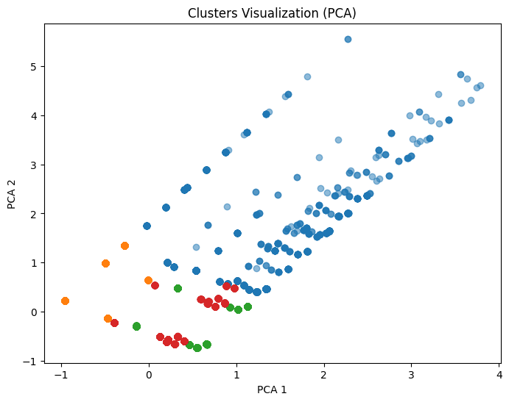
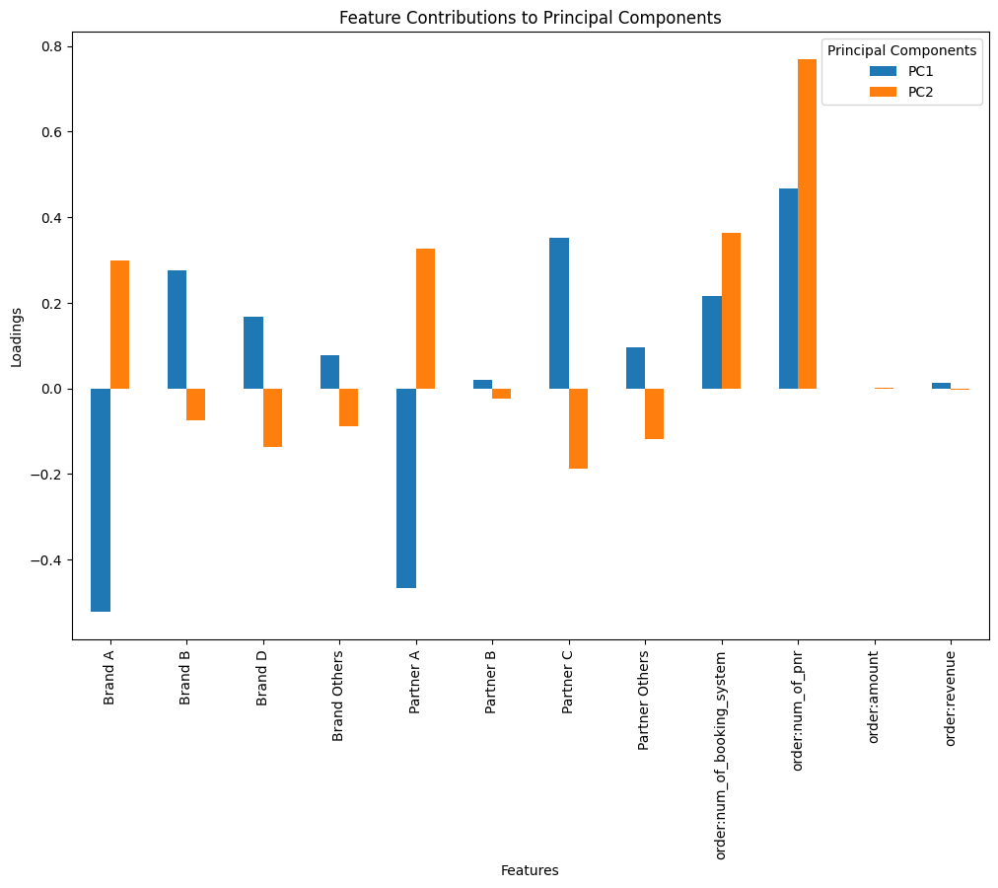
Testing the result
Exploratory Analysis and Recommendations for Efficient Customer Service
Shahrzad Khayatbashi
13th January 2025

Slide 16
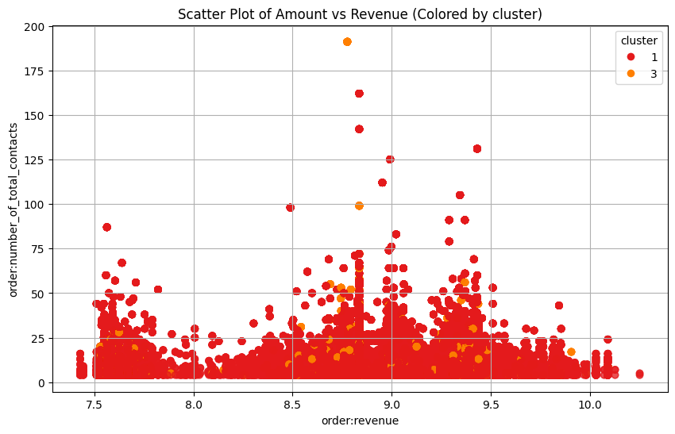
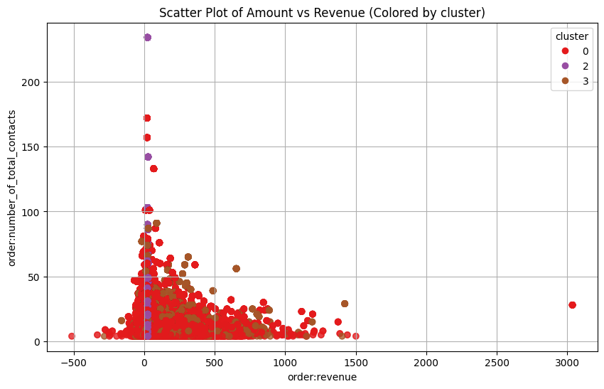
Investigating clusters based on partners
Partner A
Partner C
Threats to validity:
Lack of business knowledge
As they can trade different brands, the focus may shall be on brands, but needs further investigation based on business knowledge
Insights:
Despite the less revenue for Partner A, it recieves as much contact as Partner C.
Exploratory Analysis and Recommendations for Efficient Customer Service
Shahrzad Khayatbashi
13th January 2025

Slide 17
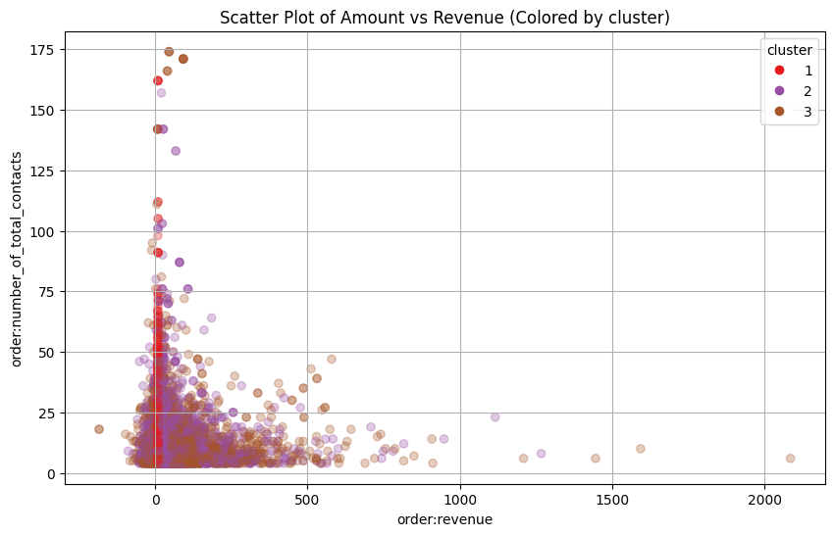
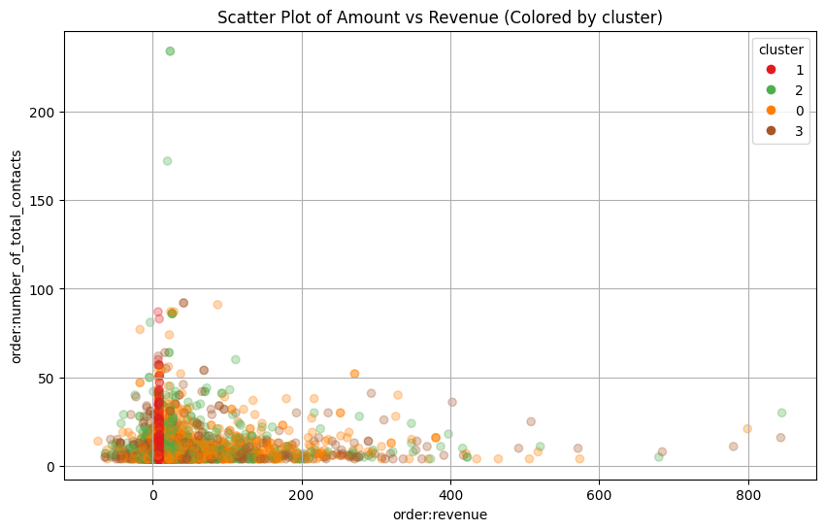
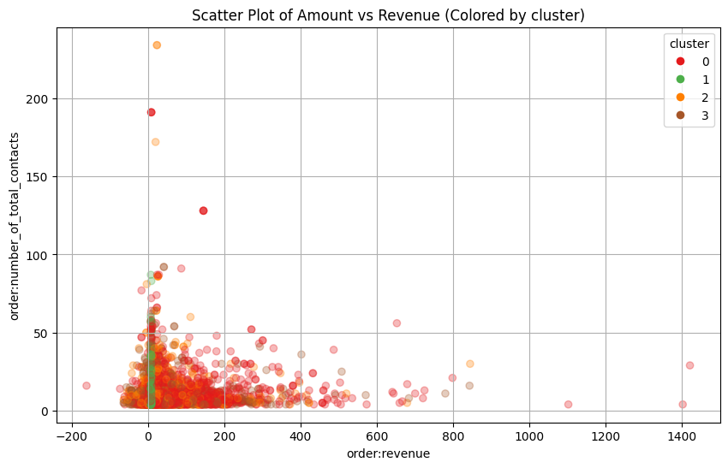

Number of PNR
Test data
1 PNR
2 PNR
<2 PNR
Test data shows that 2 PNR has room for optimization. Does this hypothesis hold for the production data?
Exploratory Analysis and Recommendations for Efficient Customer Service
Shahrzad Khayatbashi
13th January 2025

Slide 18
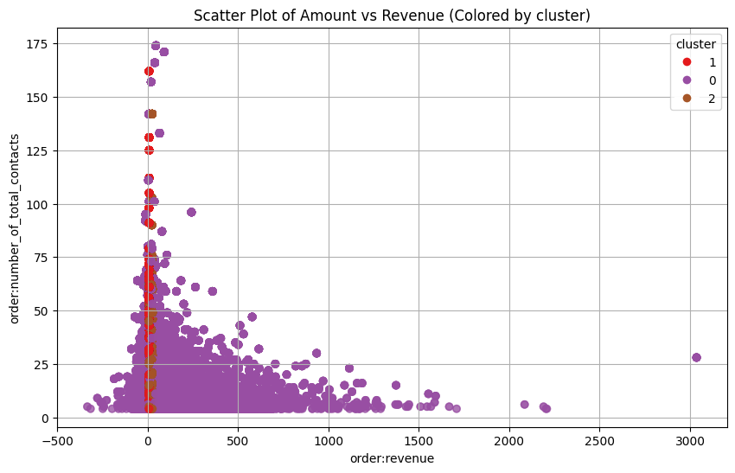
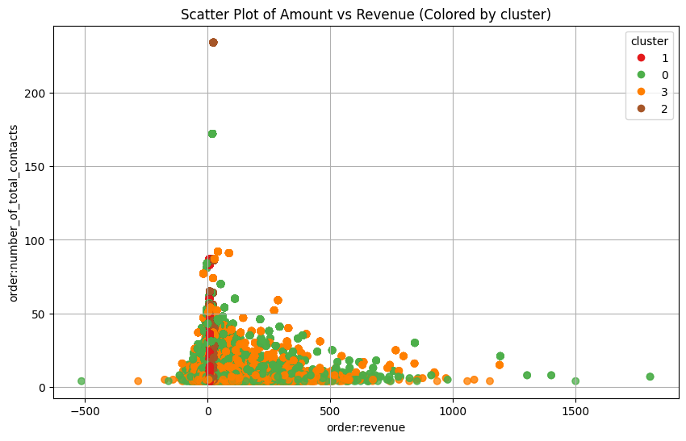
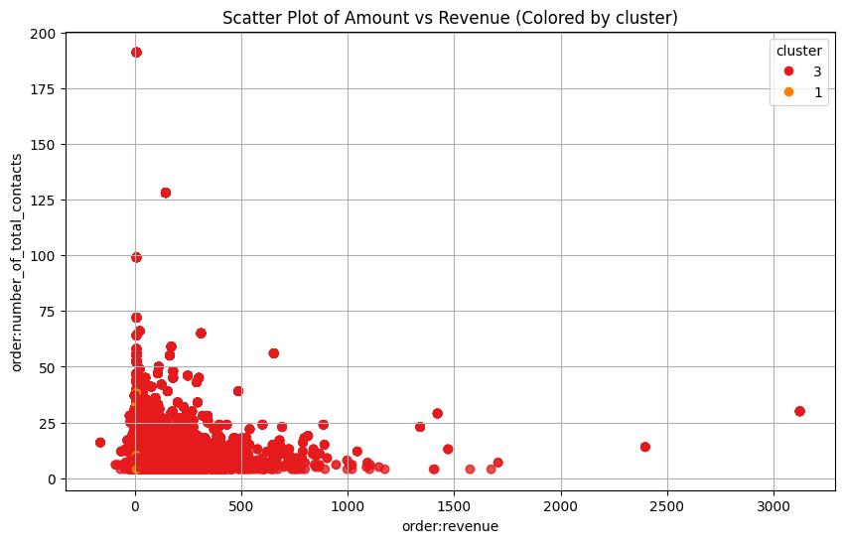
Number of PNR
The hypothesis is not hold on the production data. Probably the larger dataset is needed.
Test data
Prod data
1 PNR
2 PNR
<2 PNR
Exploratory Analysis and Recommendations for Efficient Customer Service
Shahrzad Khayatbashi
13th January 2025

Slide 19
Future analysis
Explore the data through diverse perspectives to uncover deeper insights.
Potential areas for further investigation include:
Cancellations
Booking Changes
Errand Categories
Exploratory Analysis and Recommendations for Efficient Customer Service
Shahrzad Khayatbashi
13th January 2025

Slide 20
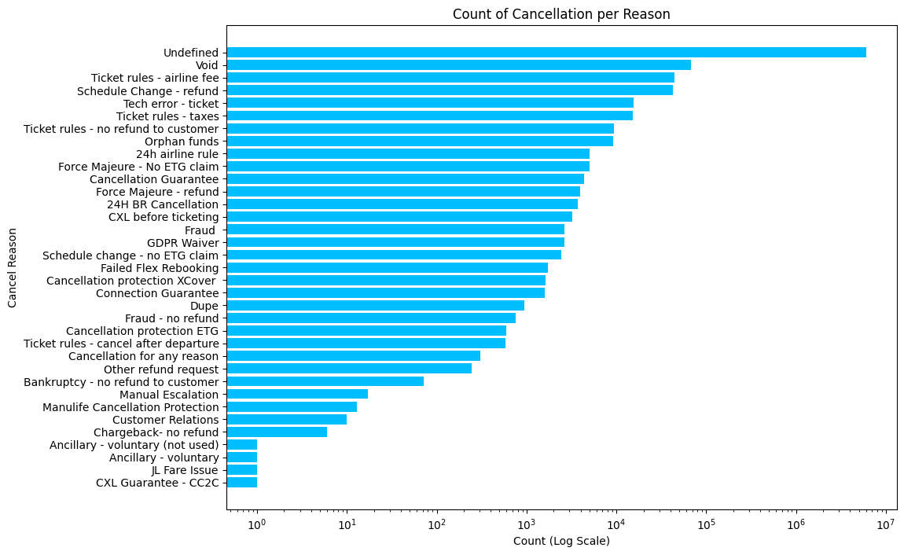
Cancellation analysis
Exploratory Analysis and Recommendations for Efficient Customer Service
Shahrzad Khayatbashi
13th January 2025

Slide 21
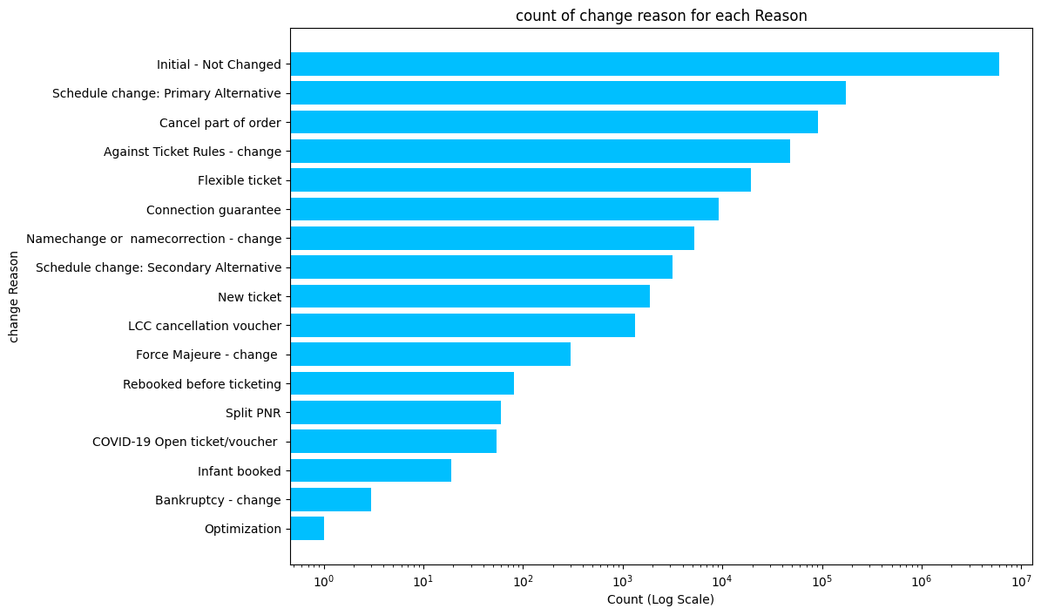
Change in booking analysis
Exploratory Analysis and Recommendations for Efficient Customer Service
Shahrzad Khayatbashi
13th January 2025

Slide 22
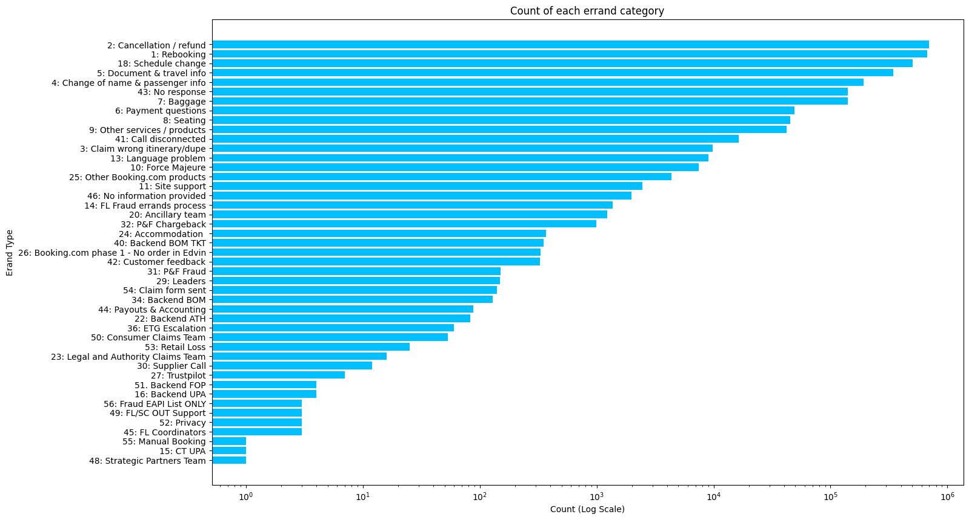
Errand category analysis
Exploratory Analysis and Recommendations for Efficient Customer Service
Shahrzad Khayatbashi
13th January 2025

Slide 23

Summary
Key insights
Which perspectives or lenses would you prioritize to use for analysis?
Exploratory Analysis and Recommendations for Efficient Customer Service
Shahrzad Khayatbashi
13th January 2025

